Slide 1
JP Morgan:
AI and Synthetic Data
Team 10

Slide 2
Overview of AI in Finance
Universal way to streamline and optimize processes
Automate 24/7 customer service
Increase fraud protection
Predict and assess loan risks
Document financial data/transactions faster and at lower cost
JP Morgan is noted as being on the forefront of this movement

Slide 3
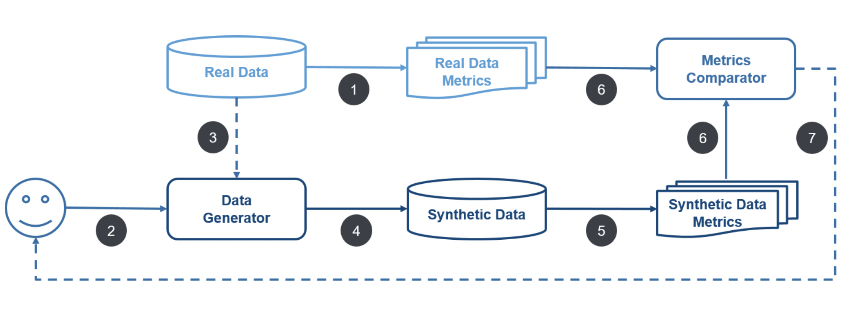
All Areas of Synthetic Data
Anti-Money Laundering (AML)
Introducing money coming from illegal activities into the financial system in order to use it for legal or illegal purposes
Customer Journey Event
Sequences of lower level retail banking clients’ interactions with the bank
Logging into an online banking app, using an ATM machine
Markets Execution Data
Data describing a series of buy and sell orders of financial instruments (stocks) by various market participants at a public stock exchange
Snapshots of trends over time
Payments Data for Fraud Detection
Transactions from a subject-centric view with the goal of identifying fraudulent transactions
Normal and non-normal transaction types

Slide 4
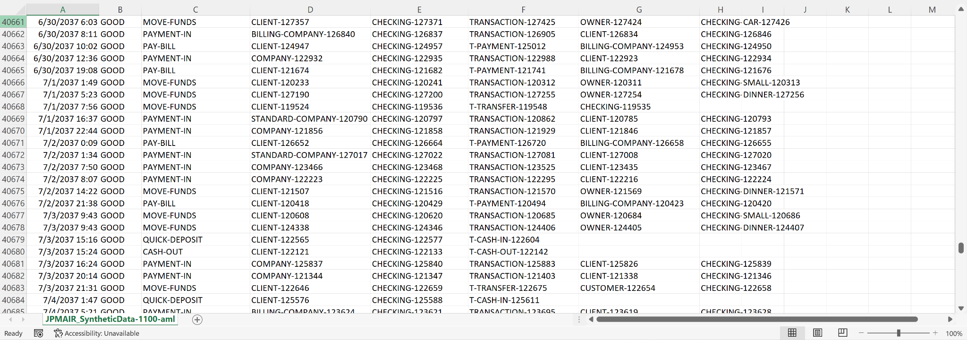
JP Morgan Data Sample

Slide 5
Paper 1: Generating Synthetic Data in Finance: Opportunities, Challenges and Pitfalls
STRENGTHS: Optimize the complex and varied data Synthesized data is fair and trustworthy Seamless operations cross-function Better customer service | WEAKNESSES/PITFALLS: SDDL and privacy ABM and data leakage Bayesian networks and scaling issues
OPPORTUNITIES: Lack of historical data Tackling class imbalance Training advanced ML models Data sharing | THREATS/CHALLENGES: Market microstructure data Data deanonymization

Slide 6
Paper 2: Simulating and Classifying Behavior in Adversarial Environments Based on Action-State Traces: An Application to Money Laundering
AML recognition simulator developed for JP Morgan AI research
Wide range of strategies available to money launders, difficult to catch up after it is already happening
3 main contributions:
New way of modeling AML as classification behaviors
CABBOT
Simulator that generates synthetic data
Entirely hypothetical data, yet to be connected to real money laundering data

Slide 7
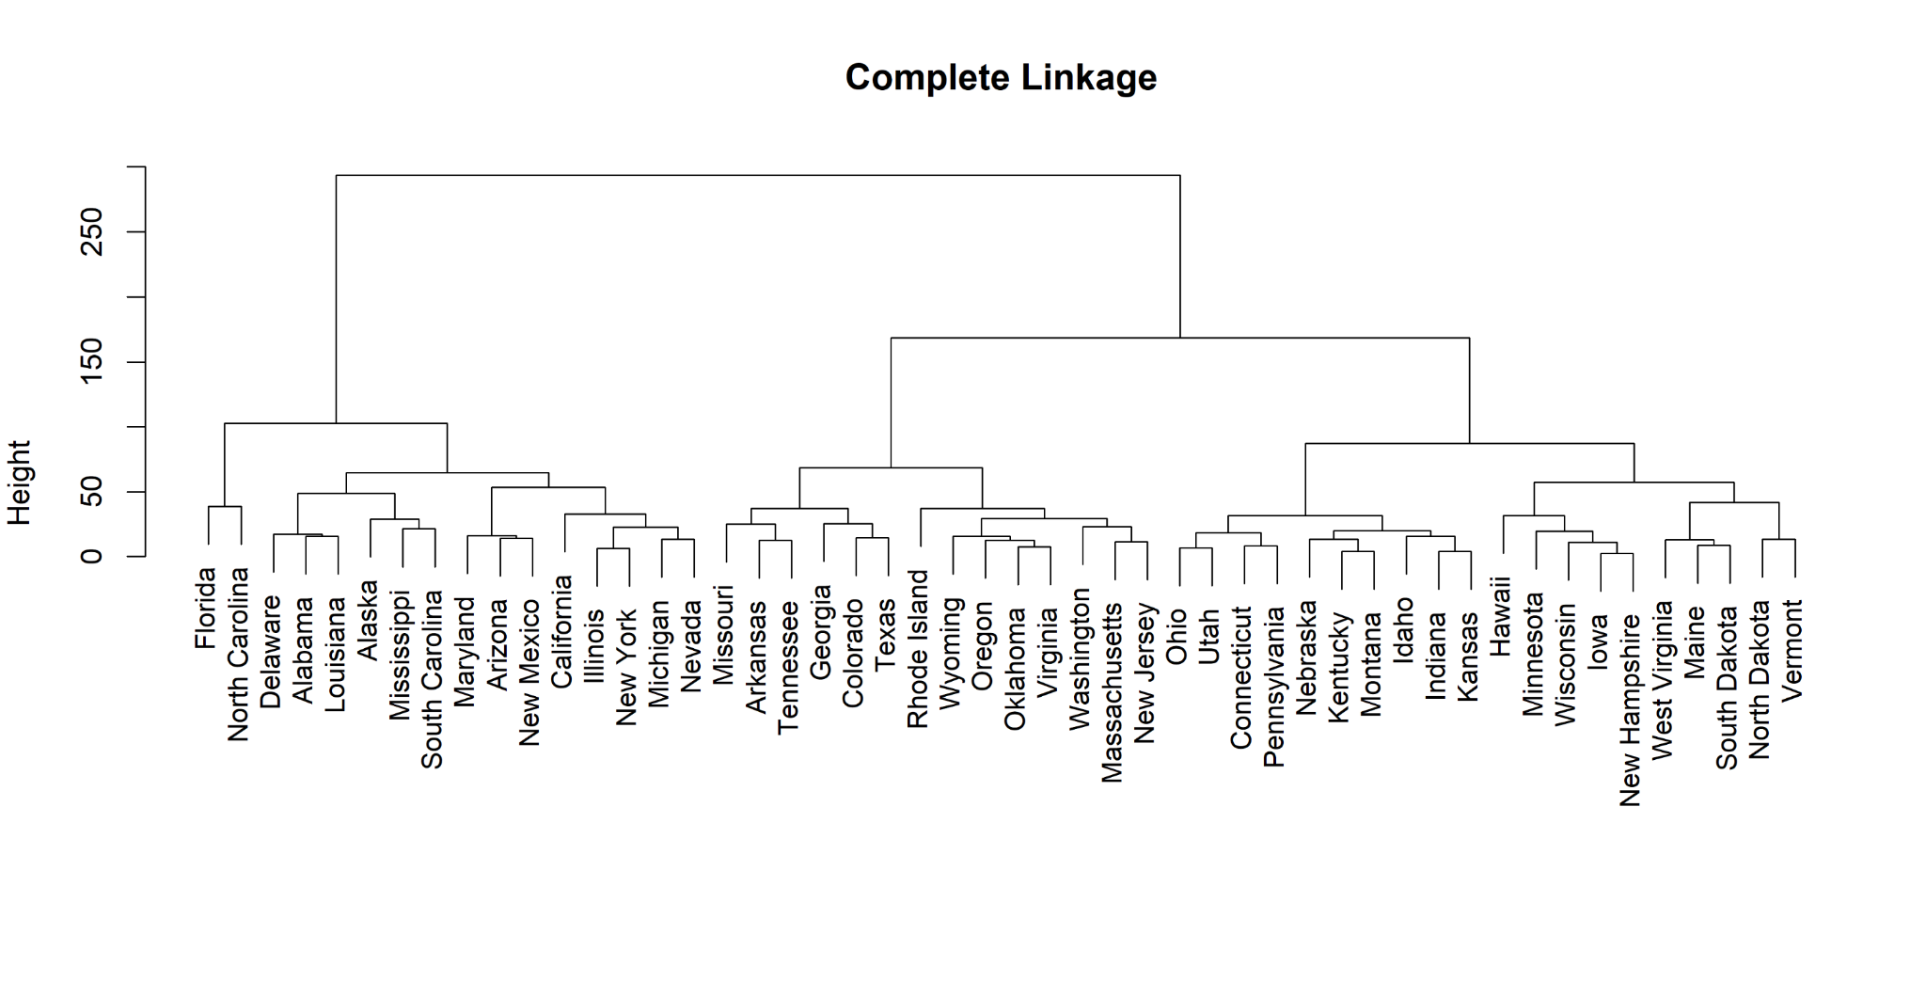
Hierarchical Clustering (Scaled vs. Non-Scaled)

Slide 8
